Slide 1
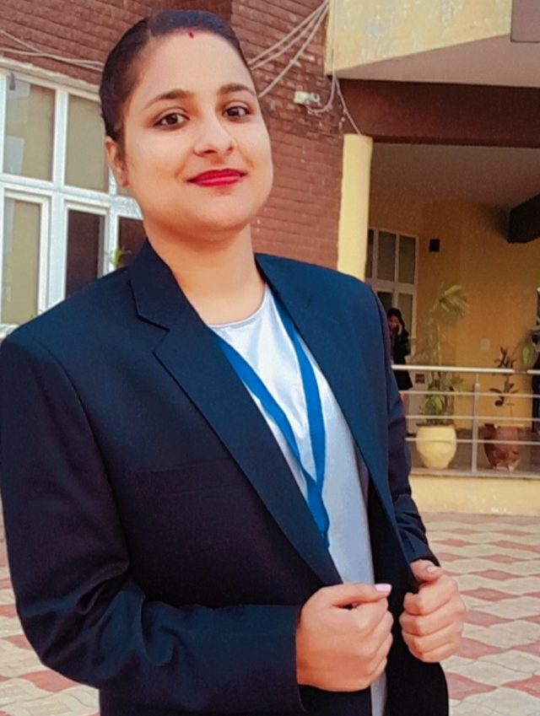
Name-Manpreet Kaur SID-301239154 Course Code-229 Course Name- Web Application Development
Assignment 1 Express Portfolio Site
Github Repo’s URL:https://github.com/mkaur2677/Portfolio-Site.github.io.git
Website’s URL: https://manpreet-portfolio-site.herokuapp.com/
Video presentation’s URL :https://youtu.be/uqBOzcuVTP8

